Slide 1


Solving Difficult Large-scale Social Problems with Root Cause Analysis
Jack Harich ▪ IESA Colloquium Series ▪ March 5, 2014

Slide 2
Present methods are not working
Large-scale Social Problems
Solved | Not Solved
Serfdom | Environmental Sustainability
Slavery | War
Basic Civil Rights | Poverty
Universal Suffrage | Excessive Income Inequality
Autocratic Rule | Large Recessions
 | Corruption
Notes:
Organized crime
Smallpox
The Failed State Problem
Recurring Wars in Europe

Slide 3

Present methods are not working because they do not resolve root causes
All problems arise from their root causes.

Slide 4
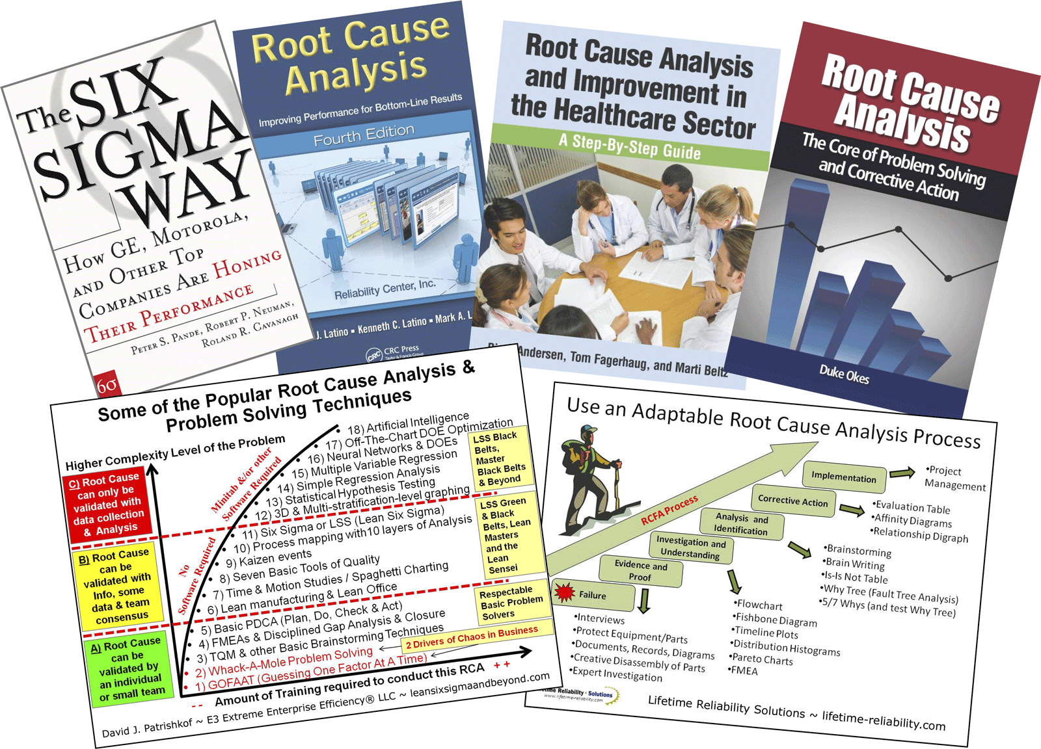
Root cause analysis works for business problems

Slide 5
If root cause analysis can work for business problems, it can work for social problems
Because all problems arise from their root causes.

Slide 6
There is a knowledge gap
We need a method for solving social problems based on root cause analysis.
Symptoms
Method
Intermediate Causes
Root Causes

Slide 7
Definition of root cause
It is clearly a (or the) major cause of the symptoms.
It has no worthwhile deeper cause.
It can be resolved.
Its resolution will not create other equal or bigger problems. Side effects must be considered.
There is no better root cause. All plausible alternatives have been considered.
Resolved means a system’s feedback loop structure is changed such that a root cause force no longer exists or is acceptably low.

Slide 8

Root causes are found by asking WHY until you arrive at the root cause
The Five Whys of Kaizen
WHY?
WHY?
WHY?
WHY?
WHY?

Slide 9

The Jefferson Memorial Erosion Problem
1. WHY is the memorial eroding?
Because it’s being washed frequently.
2. WHY is it being washed frequently?
To remove bird droppings.
3. WHY are the bird droppings there?
Because lots of birds are there.
4. WHY are there so many birds?
Because they are eating spiders.
5. WHY are there so many spiders?
Because they are eating bugs.
6. WHY are there so many bugs?
They are attracted by the floodlights. (Root Cause)
Unexpected solution:
Turn the floodlights on after dusk and before dawn.

Slide 10
An exploratory root cause analysis can be done with Social Force Diagrams
Superficial Layer
Mode
Change
New
Symptoms
Symptoms
Easy to see
Superficial Solution Forces
New
Intermediate Causes
Superficial
Solutions
Low Leverage Points
Intermediate Causes
Fundamental Layer
Hard to see, so requires root cause analysis
New
Root Causes
Fundamental
Solutions
High Leverage Points
Root Causes
Fundamental Solution Forces
Root Cause Forces
New Root Cause Forces
10

Slide 11
Social Force Diagram – Example 1
11

Slide 12
The essential characteristics of the problem solving method must include:
Superficial Layer
Problem Symptoms
1. Problem definition
2. Solution identification
3. Implementation
Intermediate Causes
Fundamental Layer
4. Root cause analysis
5. Problem decomposition
6. Feedback loop modeling
7. Generic
Root Causes
12

Slide 13
The five substeps of analysis
The essential characteristics:
1. Problem definition
2. Solution identification
3. Implementation
4. Root cause analysis
5. Problem decomposition
6. Feedback loop modeling
7. Generic
The standard three subproblems of the main problem
The four main steps
1. Problem Definition
The System Improvement Process (SIP)
Subproblems
How to Overcome Change Resistance
How to Achieve Proper Coupling
How to Avoid Excessive Solution Model Drift
Symptoms
Symptoms
Symptoms
2. Analysis
A
Find the immediate cause of the subproblem symptoms
in terms of the system’s dominant feedback loops.
Superficial Layer
Spend about 80% of your time here. The problem solving battle is won or lost in this step, so take the time to get the analysis right.
B
Find the intermediate causes, low leverage points, and superficial (symptomatic) solutions.
C
Find the root causes of the intermediate causes.
D
Find the feedback loops that should be dominant to resolve the root causes.
E
Find the high leverage points to make those loops go dominant.
Fundamental Layer
3. Solution Convergence
4. Implementation
Continuous Process Improvement – The foundation of the entire process
Notes:
Show simulation models after this slide.
Now how could we take this approach and use it in a campus club? We talked about EVSCA last time. What might an EVSCA chapter at North Georgia College?

Slide 14
Environmental Sustainability Clubs of America
A NGU EVSCA chapter would:
1. Educate members on issues of sustainability.
2. Train members in the use of analytical tools for solving sustainability problems.
3. Encourage individual or small group projects which explore specific sustainability problems. Such work might be presented to the club and elsewhere. Related videos would be published on YouTube.
4. Explore ways in which to build the reputation of NGU as a leader in cutting edge techniques for solving the sustainability problem.
5. Engage in activism aimed at applying pressure at the high leverage points of selected unsustainable activities.
6. Promote field trips to selected facilities which exemplify sustainable progress.
7. Bring in speakers which will attract media attention.

Slide 15
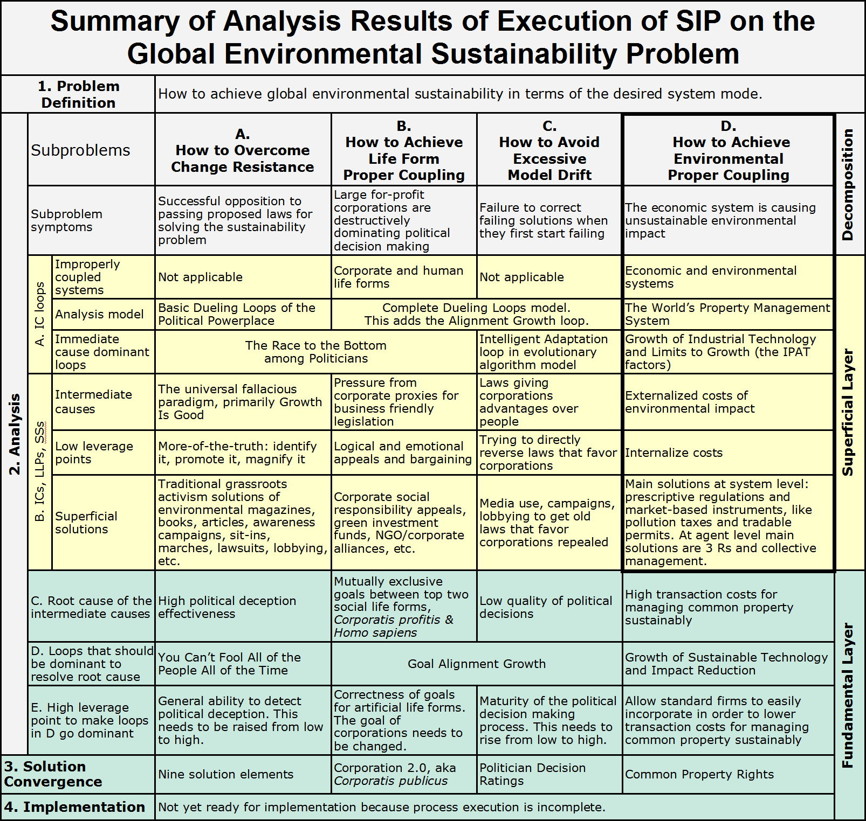
Most work is in the heavily bordered box in the upper right, which explains why the problem remains unsolved.
Solvable
Only if we expand our analytical awareness to this layer.
Notes:
Here’s a chance to briefly show the running Dueling Loops model, with its dominant Race to the Bottom.

Slide 16
The sustainability problem is a side effect of a deeper problem
Not Solved
Solved
A – Change Resistance Subproblem
B – Life Form Proper Coupling Subproblem
C – Solution Model Drift Subproblem
D – Environmental Proper Coupling Subproblem
E – Economic Unsustainability
F – Social Unsustainability
A – Change Preference
B – Implicit Goal of the System
C – Solution Self-management
D – Environmental Sustainability
E – Economic Sustainability
F – Social Sustainability

Slide 17

Our key research conclusions
Sustainability solutions are failing because they do not resolve the root causes.
Why? Because present problem solving methods are not root cause analysis driven.
The powerful business tool of root cause analysis can be adapted to social problems.
Preliminary analysis shows the most pressing social problem of them all, the sustainability problem, is solvable.

Slide 18
Extra Slides Follow

Slide 19
Present methods for solving social problems
Intuition (no real analysis)
Integrated models (World3)
Design principles (Precautionary)
Comparative method (Multiple cases)
Comprehensive frameworks (A process based on organizing principles)

Slide 20

What the experts say – Example 1
“The problem demands a solution with a clear framework and a strong backbone. ... The essential backbone is a rising price on carbon....” (p205)
Intuition

Slide 21

What the experts say – Example 2
“This book employs the comparative method to understand societal collapses to which environmental problems contribute. ... Only from the weight of evidence provided by a comparative study of many societies with different outcomes can one hope to reach convincing conclusions.” (pp18-19)
Comparative Method

Slide 22

What the experts say – Example 3
[The founders of the field of sociology] viewed themselves as not only scientists but also social engineers, whose aim was to apply the knowledge of their discipline to solving social problems.... (p331)
“[The problem to solve] is how to best use representative political systems, especially in relation to corporate activities, so that the results of planning truly serve the interests of citizens.” (p337)
Approaches: (pp338-339, survey) 1. Expert driven planning 2. Democratic planning 3. Community organizing 4. Political movements
Intuition and Design Principles

Slide 23
Social Force Diagram – Example 2

Slide 24
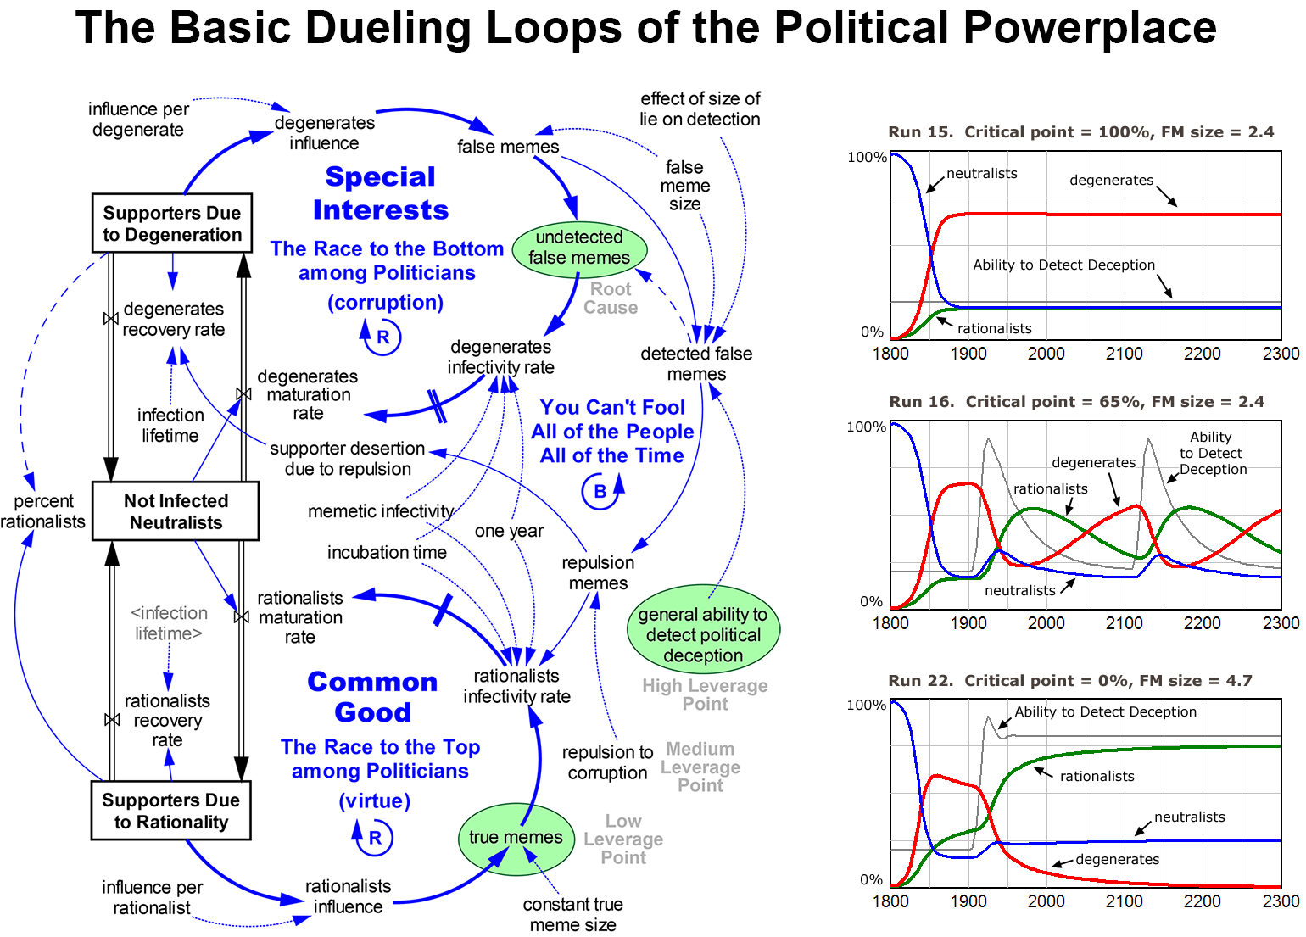
Notes:
Demonstrate DuelingLoops_WithCriticalPointReaction.mdl. Do a few runs. List parameters, rehearse.

